Slide 1

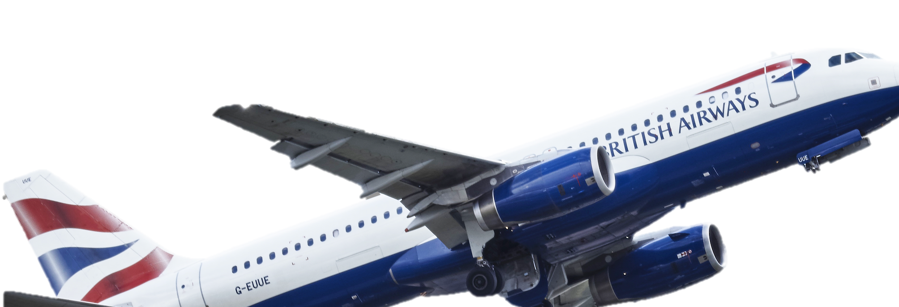
Insights from negative reviews of the company

Slide 2
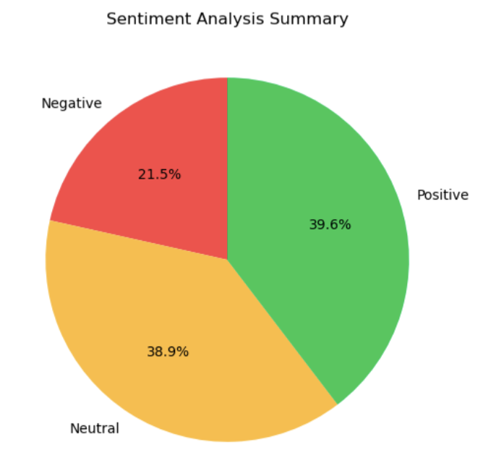
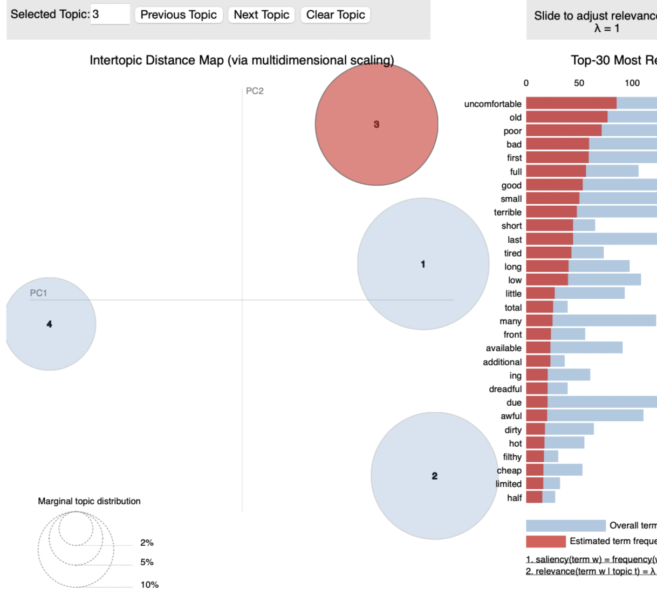
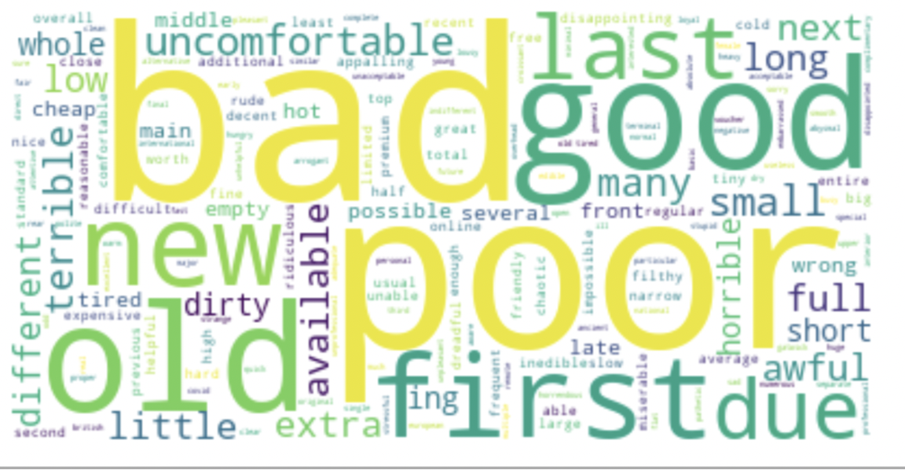
- Sentiment analysis indicates that 22% of the reviews are negative and 39% are positive.
- A word cloud of negative reviews shows that people dislike mainly the food, seats, flight hours and service.
LDA model shows 4 main topics which people complain about: uncomfortable seats, poor service, rude attention and long lines

Slide 3
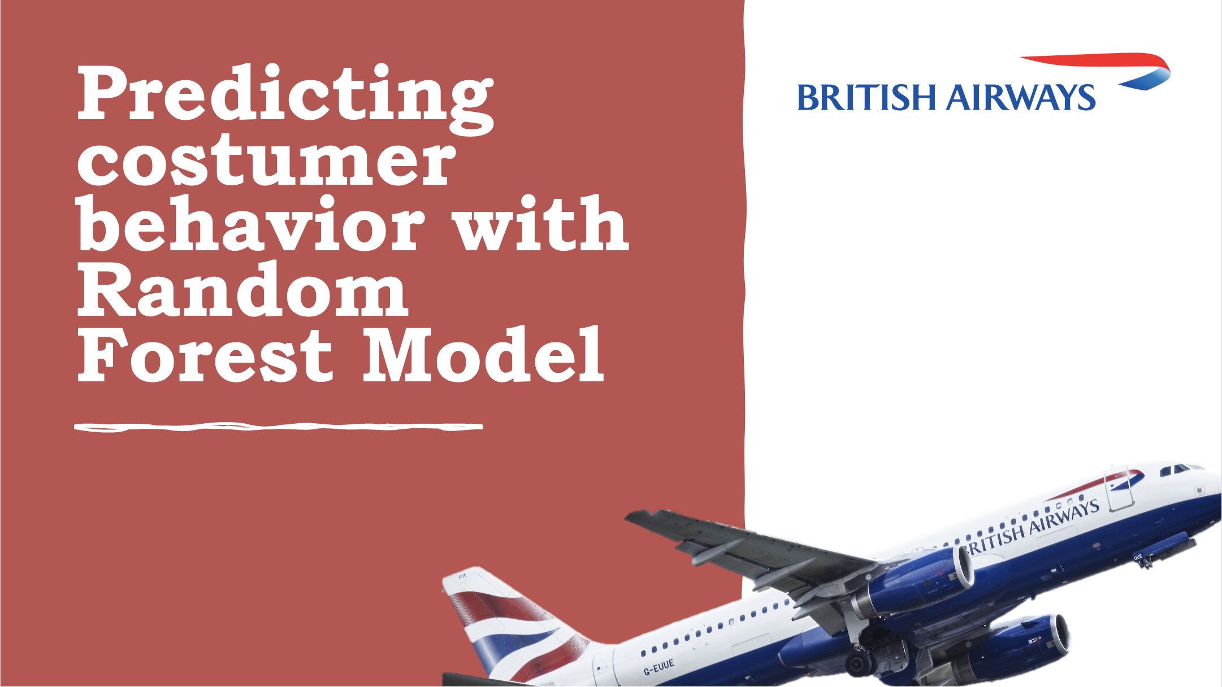
Insights from negative reviews of the company

Slide 4
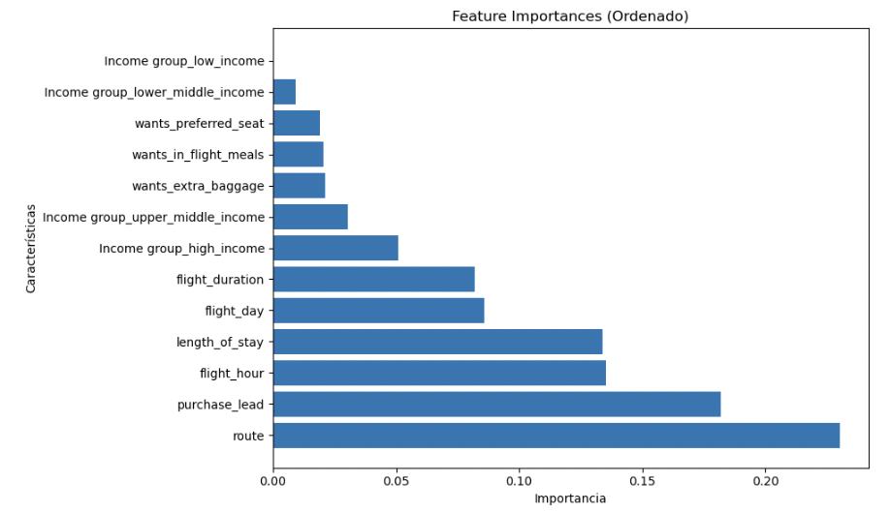
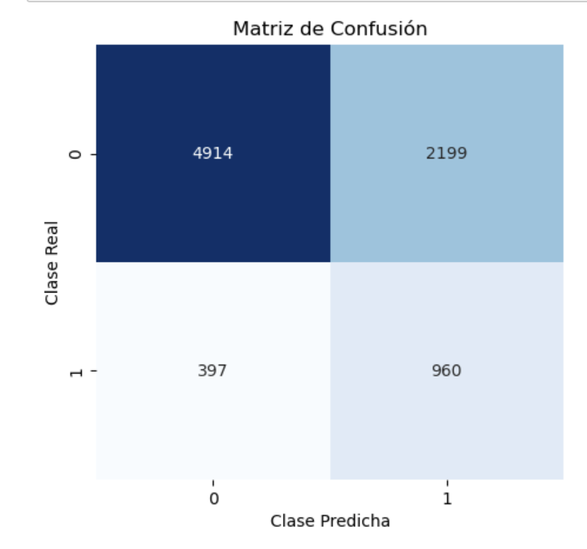
Among the tested models, the Random Forest Model with downsampling shows better performance and the highest predictive capacity for flight booking behavior.
Customers prioritize their decisions based on the specific route, timing, and duration of their stay.
These insights can inform marketing strategies, flight scheduling, and customer segmentation

